Slide 1
IMDB MOVIES
Data Analysis
Prepared by:
Winnie Njoroge

Slide 2

Main Goal
Microsoft wants to create successful and high-grossing films

Slide 3
Understanding the Context
Microsoft sees all the big companies creating original video content and they want to get in on the fun. They have decided to create a new movie studio, but they don’t know anything about creating movies. You are charged with exploring what types of films are currently doing the best at the box office. You must then translate those findings into actionable insights that the head of Microsoft's new movie studio can use to help decide what type of films to create.

Slide 4
Experimental Design
1. Business Understanding
2. Data Preparation
* Reading the Data
* Checking the Data
3. Data Cleaning
4. Feature Engineering
5. Performing EDA to answer specific Objectives:
Identify the most financially successful movie genres
Analyze the impact of ratings/votes on financial success
Examine the performance of existing studios
Explore trends in movie performance
6. Summary and Conclusion
7. Data Relevance

Slide 5
Analysis
A Detailed analysis can be found on the following github repository hosting the data as well as Google Colab notebook: https://github.com/NjorogeWinnie/IMDB-Movie-Data-Analysis/tree/main

Slide 6
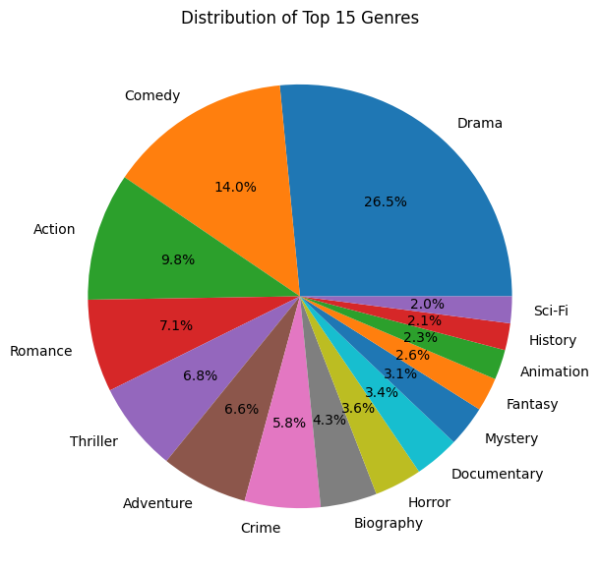
Most financially successful movie genres
Based on this piechart, we can see that drama, comedy and action are the most prevalent genres in this dataset.
However, to make these findings actionable for Microsoft,
let us investigate if the prevalence of a genre correlates with its success.

Slide 7
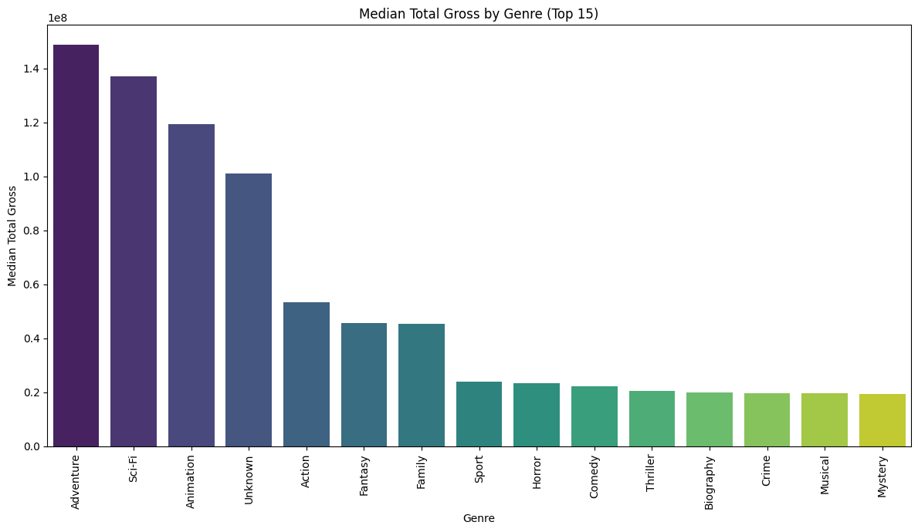
Most financially successful movie genres
The top performing genres are Adventure, Sci-fi and Animations. This suggests that movies in these genres tend to earn significantly more at the box office compared to others in the dataset. Comparing this to the pie chart earlier, where Drama and Comedy are the most prevalent genres in the dataset, their median total gross is considerably lower than the top-performing genres. This indicates that while many movies are made in these genres, their typical financial return is not as high as that of genres like Adventure or Sci-Fi.
Action movies are also prevalent and show a moderate median total gross, placing them below the top three but still higher than many other genres.
From these insights drawn from the analysis above, we would advise Microsoft to focus on Adventure, Sci-Fi and Animated Movies to maximize their financial success.

Slide 8
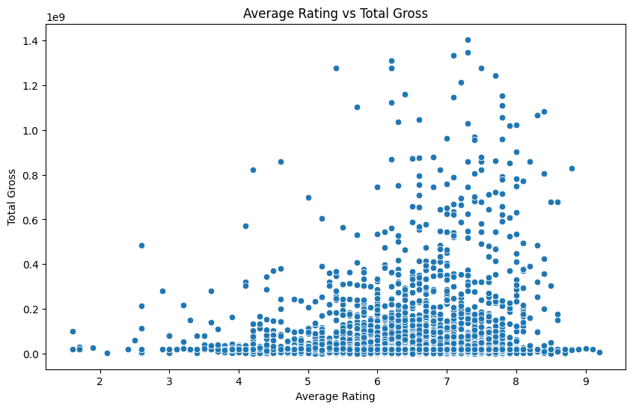
Impact of Ratings on financial success
There is a weak positive trend between Ratings and Total gross. There are high grossing movies with high ratings, while there are high grossing movies with average or below average ratings.
Conversely, there are movies with high ratings that did not achieve very high total gross.
This confirms that a high average rating does not guarantee high box office success, and many successful movies are not necessarily the most critically acclaimed

Slide 9
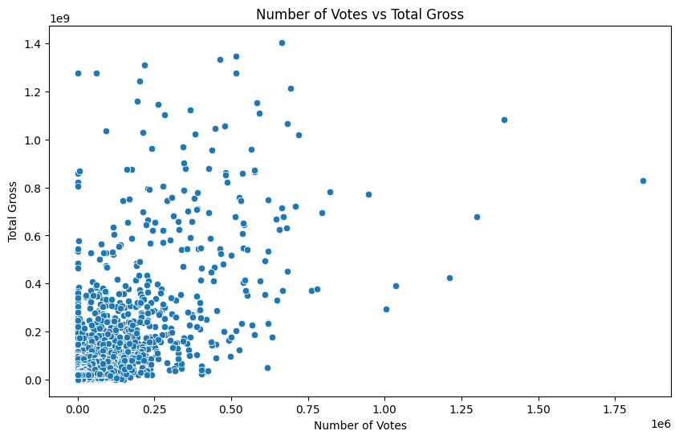
Impact of Votes on financial success
The scatter plot above, shows a clearer positive trend than the rating vs. gross plot. As the number of votes increases, the total gross tends to increase.
There is a visible cluster of movies with lower votes and lower gross, and as you move to higher vote counts, the potential for higher total gross generally increases.
This suggests that movies that generate more audience engagement (indicated by a higher number of votes) are more likely to achieve higher box office revenues.
The number of votes appears to be a better indicator of potential financial success than the average rating.
From the above analysis, we can advise microsoft that audience engagement matters more for Revenue.

Slide 10
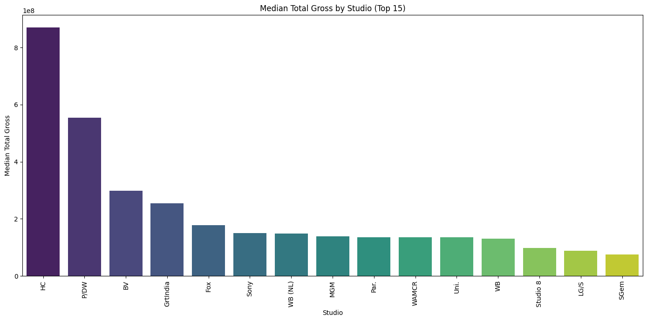
Performance of existing studios
The bar plot clearly highlights the studios with the highest median total gross revenue. These are the studios whose typical movies tend to earn the most globally. Based on the output, studios like HC, P/DW, and BV appear to have the highest median total gross.

Slide 11
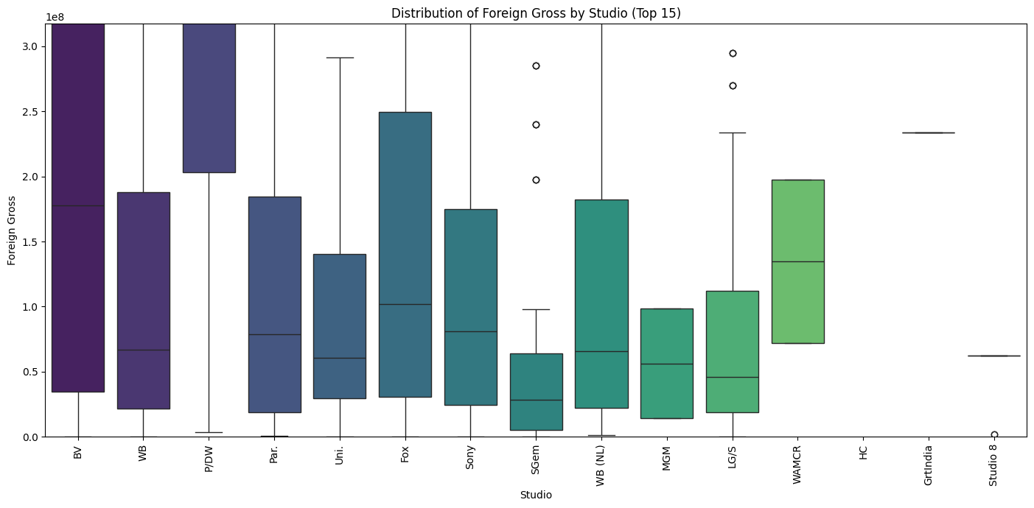
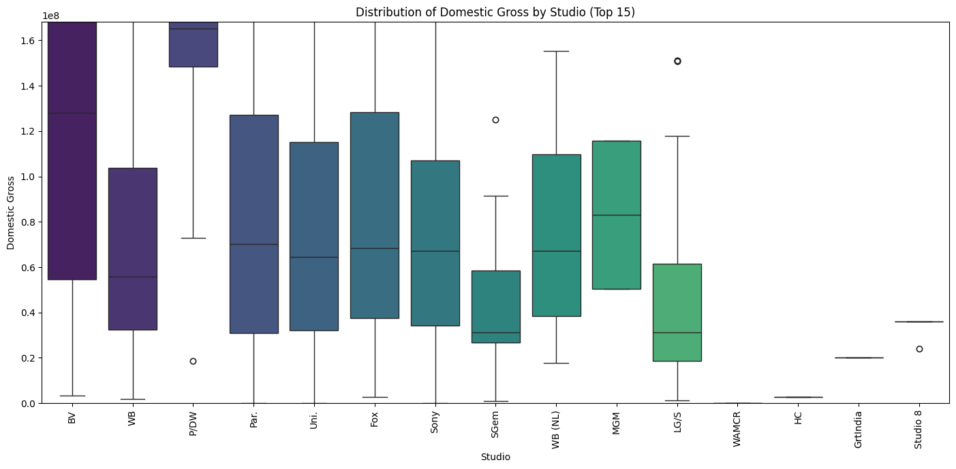
Performance of existing studios
Studios like BV, P/DW, and Fox appear to have relatively high median domestic gross.This suggests that their typical movies perform well in the domestic market.
HC, P/DW, and BV stand out with very high median foreign gross. This suggests their typical movies are particularly successful in international markets.
This analysis provides insights into the competitive landscape of movie studios which helps Microsoft understand:
1. The most financially successful existing studios based on their median gross
2. The range and variability of earnings for movies produced by these top studios.
3. How certain studios excel in domestic and foreign markets, or in producing
consistent earners versus high-risk/high-reward blockbusters.
This information is useful to Microsoft's strategy regarding potential partnerships, talent acquisition, or the types of films they might aim to produce based on the performance patterns of established studios.

Slide 12
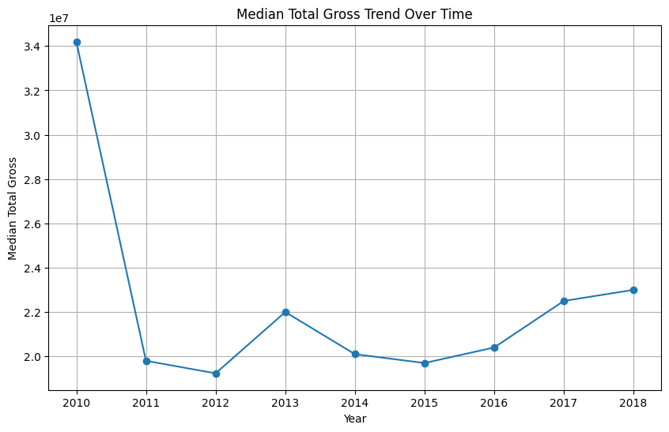
Total Gross Over Time
From the line graph above, we see that there was significant decline in total gross from 2010-2011, this could be an anomaly based on the specific movies included in the dataset, or it could mean that there was a great market shift for movies between 2010-2011.
However, after 2011, the median total gross appears to fluctuate but generally remains in a similar range, with a slight upward trend from 2016 to 2018.
There isn't a clear, consistent upward trend in median total gross across the entire period (2010-2018). This suggests that while some years might have performed better than others in terms of typical movie revenue, the market's overall median financial performance hasn't drastically increased within this timeframe based on this dataset.

Slide 13
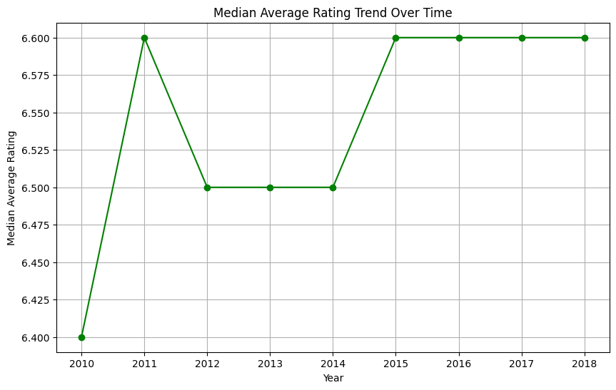
Average Rating Over Time
The median average rating starts at 6.4 in 2010 and quickly rises to 6.6 in 2011.
From 2011 onwards, the median average rating remains relatively stable, hovering around 6.5 and 6.6.
There is no strong upward or downward trend in median average rating over the years covered. This indicates that, on average, the critical or audience reception (as reflected in ratings) of movies hasn't changed significantly from 2011 to 2018 within this dataset.

Slide 14
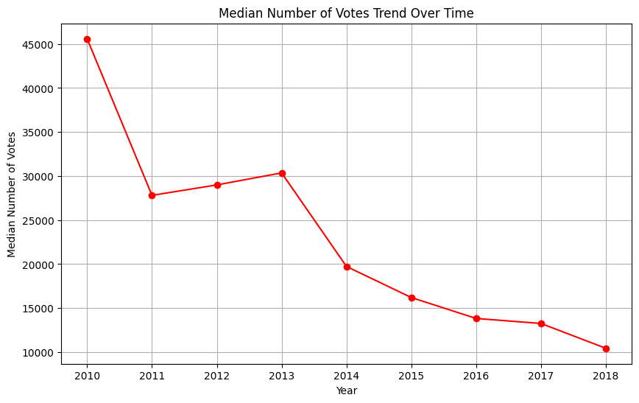
Number of Votes Over Time
The median number of votes shows a clear downward trend from 2010 to 2018. There's a sharp drop from 2010 to 2011, and then a more gradual but consistent decline in the following years.
This trend suggests that the typical movie in this dataset is receiving fewer audience votes over time. This could indicate a decrease in audience engagement.

Slide 15
Summary and Conclusion
Based on the analysis we have performed above, we can make the below conclusions:
**1. Most Financially Successful Movie Genres:**
* Adventure, Sci-Fi, and Animation genres demonstrate the highest median total gross revenue among the genres analyzed. While Drama and Comedy are prevalent, their typical financial returns are significantly lower.
* Based on this, we advise Microsoft to prioritize producing movies in **Adventure, Sci-Fi, and Animation** genres to maximize their potential for high box office returns.
**2. Impact of Ratings and Audience Engagement on Financial Success:**
* The number of audience votes is a better indicator of potential total gross revenue than the average rating. High ratings alone do not guarantee high box office success, but movies with higher audience engagement (more votes) tend to perform better financially.
* Based on this, we advise Microsoft to focus on creating movies that generate significant **audience engagement and buzz**. Marketing and distribution strategies should prioritize reaching a wide audience and encouraging interaction.
**3. Performance of Existing Studios:**
* Studios like HC, P/DW, and BV show high median total gross, indicating strong typical performance. The analysis of domestic and foreign gross distributions reveals that some studios excel in specific markets and have varying levels of consistency and potential for blockbusters.
* Based on this, Microsoft can study and learn from the strategies of successful studios, particularly those with high median gross and consistent performance in target markets. This could inform decisions about genre focus, production scale, and potential talent acquisition or partnerships. Understanding the variability in earnings can also help Microsoft define its own risk tolerance and production goals (consistent earners vs. high-risk blockbusters).
**4. Trends in Movie Performance:**
* Median total gross has been relatively stable after an initial dip in 2011. Median average ratings have also remained consistent. However, the median number of audience votes has shown a clear downward trend from 2010 to 2018.
* The declining trend in audience engagement (votes) is a significant factor. Microsoft needs to develop strategies to counteract this trend and ensure their movies capture audience attention and generate interaction in a competitive market. Simply producing movies may not be enough; focusing on unique concepts, effective marketing, and engaging content will be crucial.

Slide 16
Recommendations
To enter the movie industry successfully, Microsoft should strategically focus on **high-grossing genres like Adventure, Sci-Fi, and Animation**. While striving for quality (good ratings), they must prioritize **generating strong audience engagement** as this correlates more closely with financial success.
Understanding the landscape of existing successful studios and the **trend of declining typical audience engagement** is vital for developing a competitive strategy that aims to stand out and capture market attention.

